Slide 1





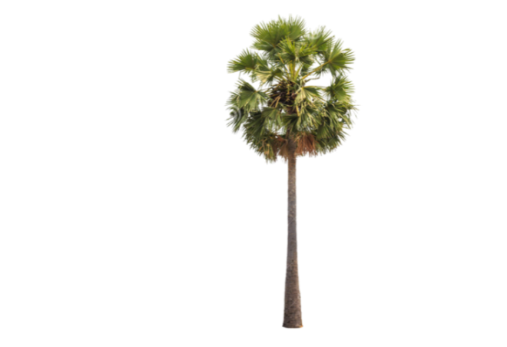
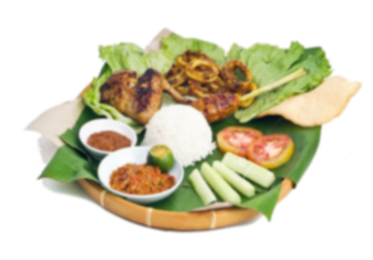
Njrpa RNjrkUj;Jt khehLk;> fz;fhl;rpAk; - 2017
aho;g;ghzg;gy;fiyf;fofr; rpj;jkUj;Jtg; gpupTk;> tlkhfhz RNjrkUj;Jtj; jpizf;fsKk; ,ize;J elhj;Jk; Njrpa
RNjrkUj;Jt khehL kw;Wk; fz;fhl;rp
(2017k; Mz;L ijkhjk; 27> 28> 29Mk; jpfjpfspy;);
khehl;bd; fUg;nghUs;
“,aw;ifAld; ,ize;j MNuhf;fpa tho;it Nehf;fp”
Ma;Tg;Gy cg jiyg;Gfs;
#oYk; kUj;Jtj; jhtuq;fspd; guk;gYk;.
RNjrkUj;Jtj;jpd; Ma;TfSk; RNjrkUj;JtKk;.
NahfhrdKk; tpisahl;L tpQ;QhdKk;.
capupay; tpQ;Qhdk;.
RNjrkUj;Jt Vl;Lr; Rtbfs;.
kUj;JtKk; RfhjhuKk;.
tptrhaKk; czT tpQ;QhdKk;.;
Md;kPfk;.
r%ftpQ;Qhdk;.
rpj;jkUe;jpay;.
Kf;fpakhd jpfjpfs; gjpTf;fl;lz tpguk; ;
jiyth;
lhf;lh;;;;;;;;; jpUkjp tp .rj;jparPyd; 0716222529
XUq;fpizg;ghsh;
lhf;lh;; jpUkjp j. jpyPgd; 0770556790
nrayhsh;
lhf;lh; nry;tp tp. rz;Kfuh[h
0777490634
Ma;Tr; RUf;fj;Jld; mjd; tpupTk; rku;g;gpj;jy; | 22.10.2016
Ma;Tf; fl;Liu Vw;Wf; nfhs;sg;gl;lij mwptpj;jy; | 30.10.2016
Kd;gjpT nra;jy; | 30.10.2016 Kjy; 10.01.2017
Kd;gjpTf;F gpd;duhd gjpT | 11.01.2017 ,Ue;J khehLtiu
 | khehL ,uhNghrdj;Jld; | khehL ,uhNghrdk; (,d;wp)
Kd;gjpT | 2500/= | 1500/=
khehl;bd; NghJ gjpT | 3000/= | 2500/=
khztu; gjpT | ---- | 1000/=

